Slide 1
Query Optimization Joins
https://www.youtube.com/channel/UCb9okJF6NGPDUGgAQxu3TcA
Video lectures of Mrs Manisha Nirgude

Slide 2
Types:
Nested-loop join
Block nested-loop join
Indexed nested-loop join(Single-loop join)
Merge-join
Hash-join

Slide 3
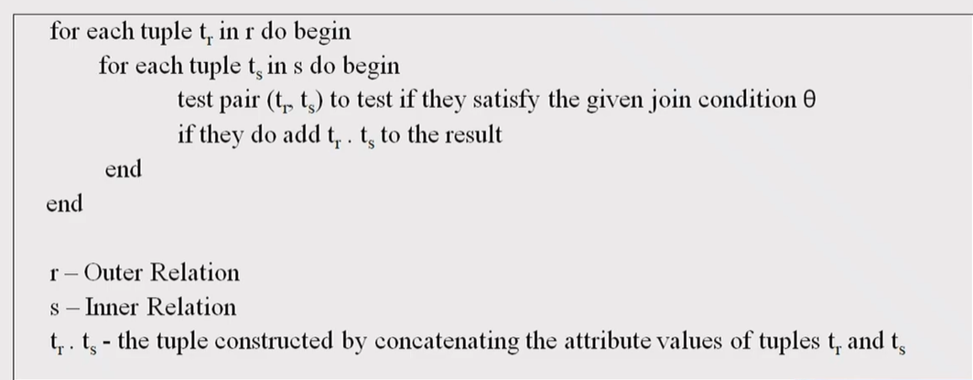
Nested Loop Join

Slide 4
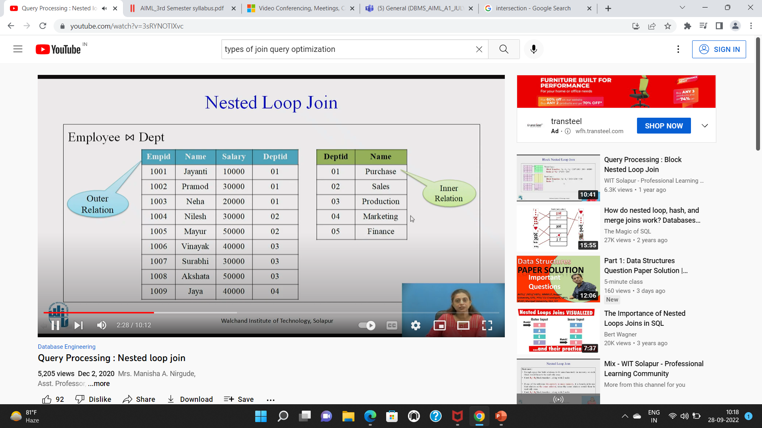
Nested Loop Join

Slide 5
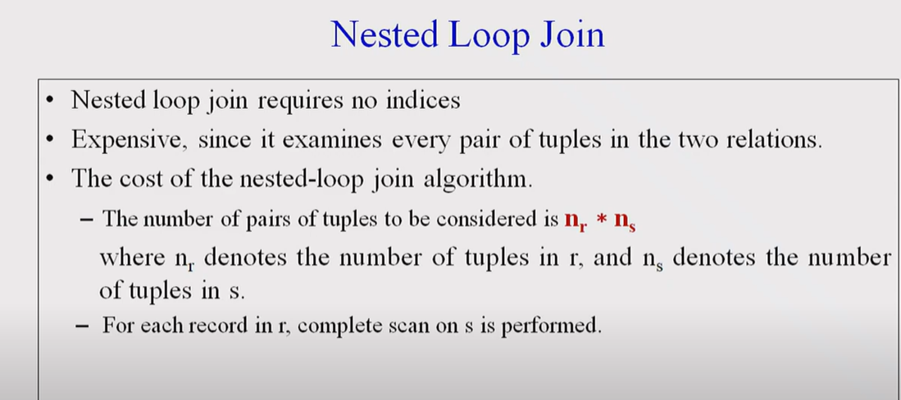

Slide 6
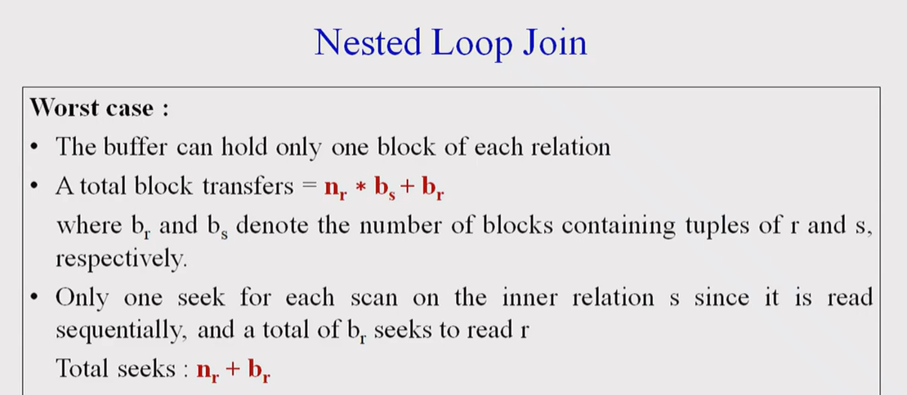

Slide 7
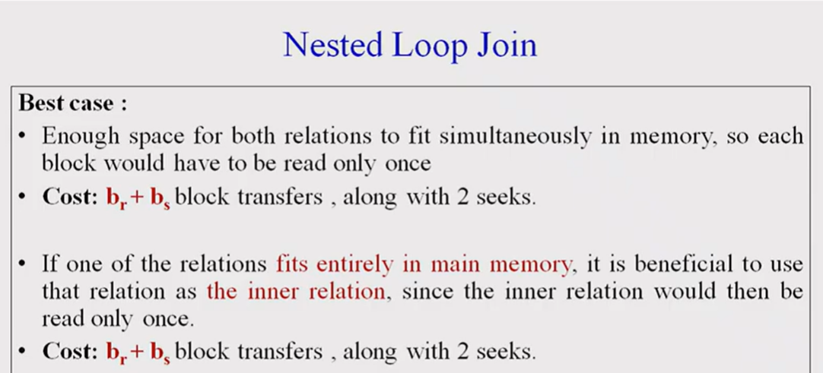

Slide 8
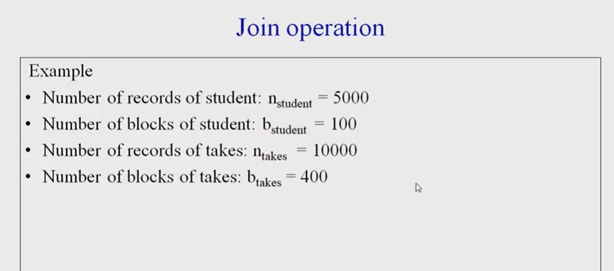

Slide 9
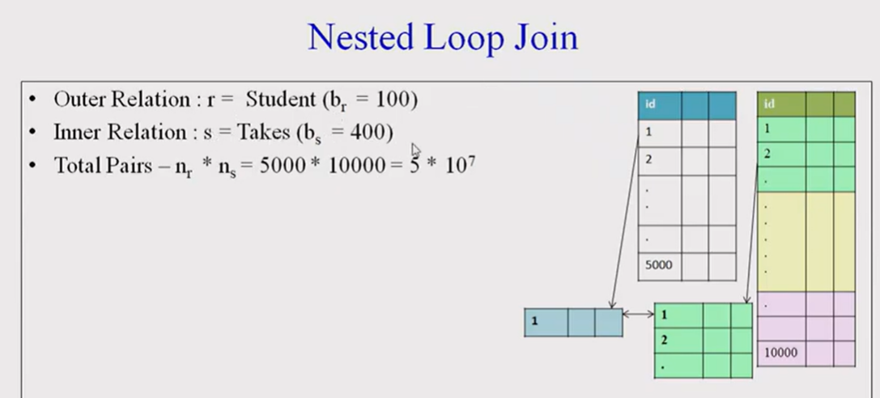

Slide 10
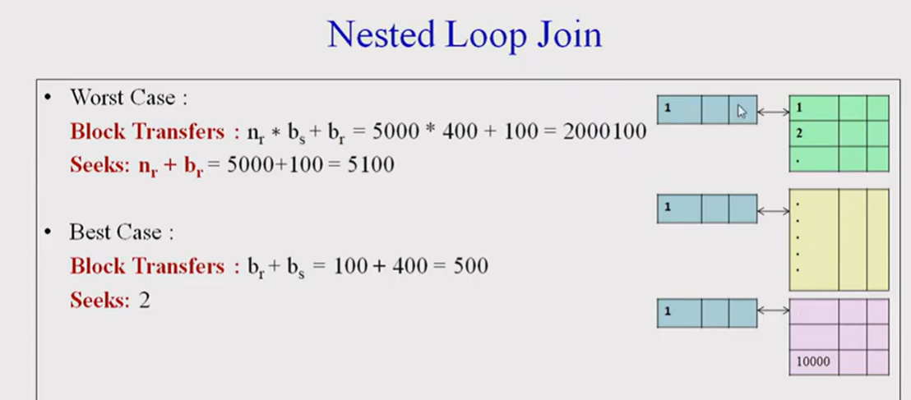

Slide 11
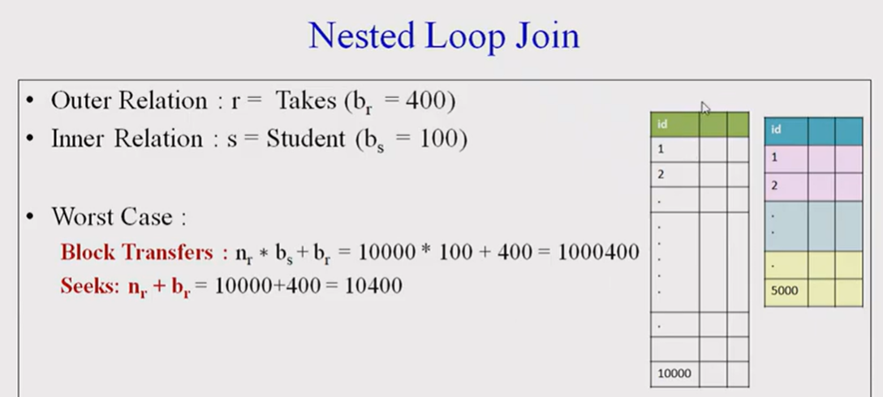

Slide 12


Slide 13
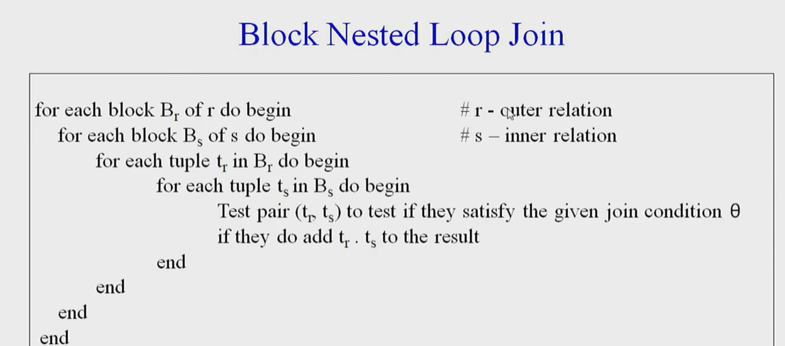

Slide 14
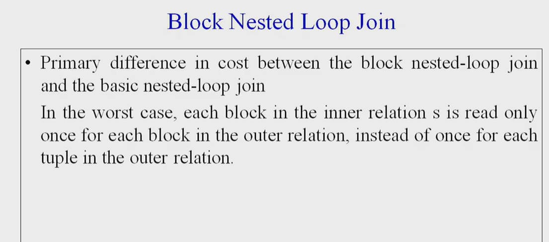

Slide 15
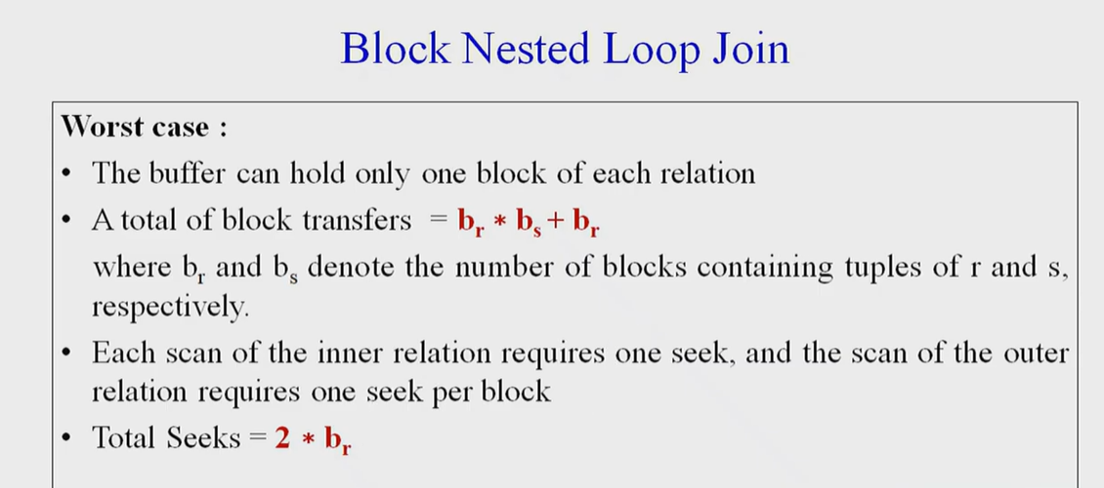

Slide 16
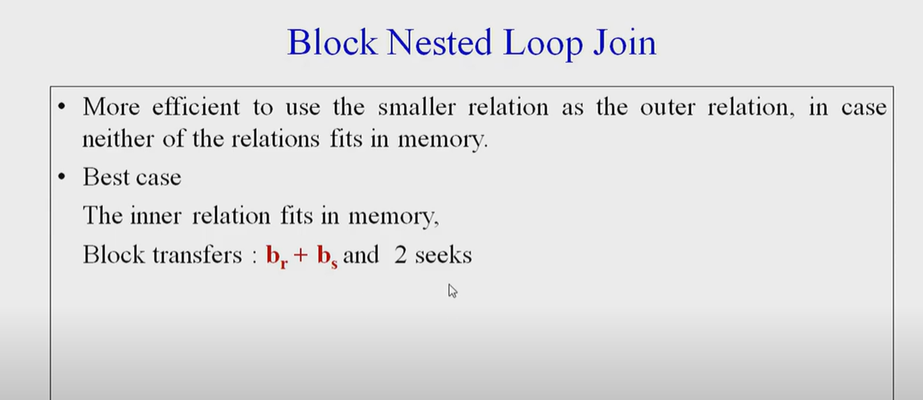

Slide 18
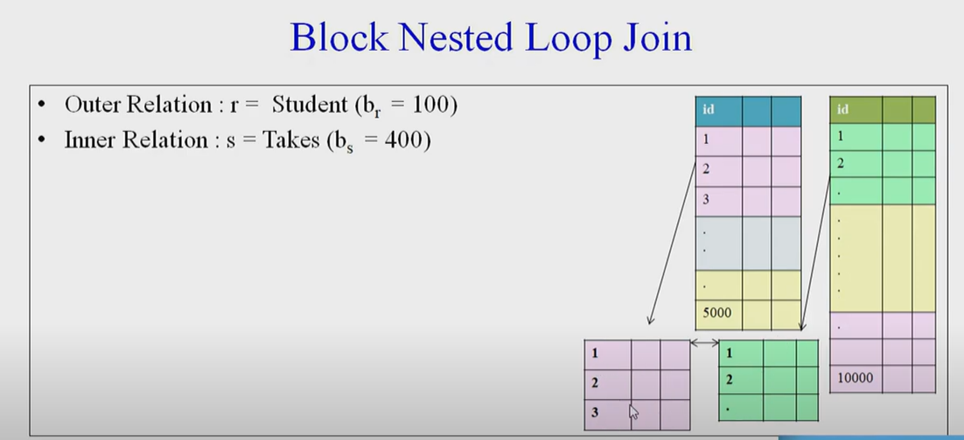

Slide 19
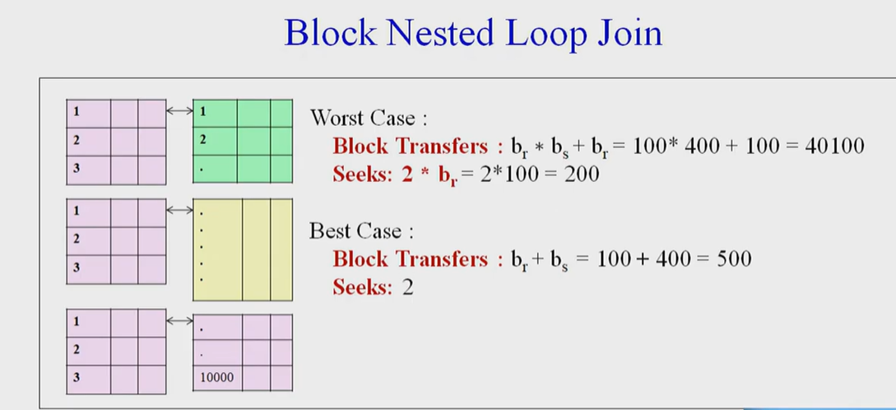

Slide 20
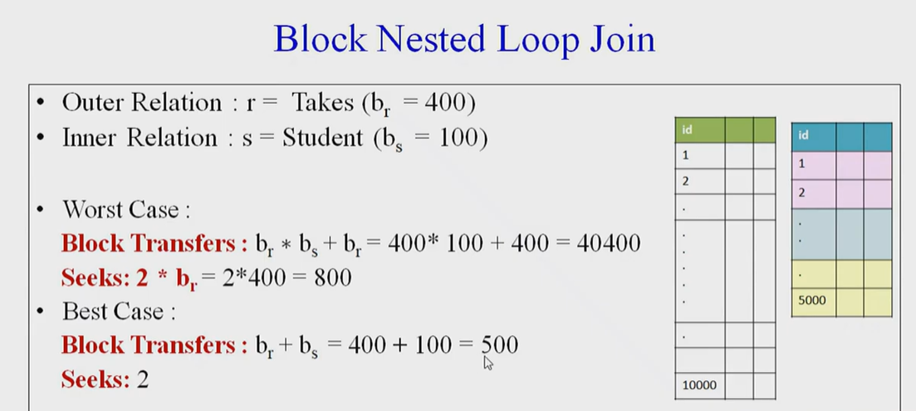

Slide 21
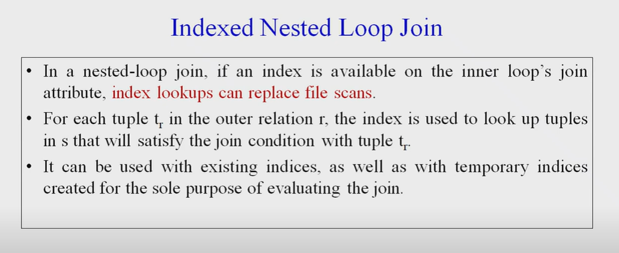

Slide 22
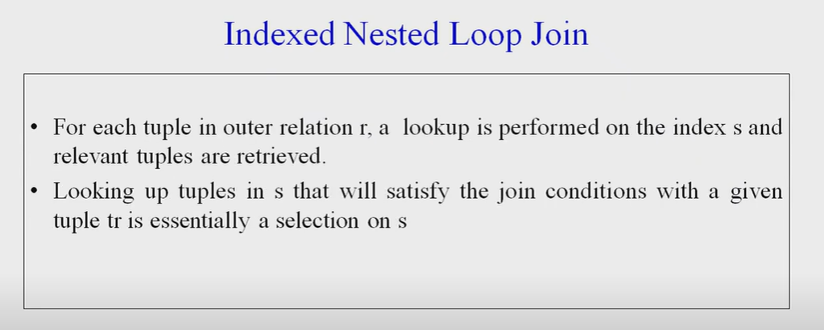

Slide 23
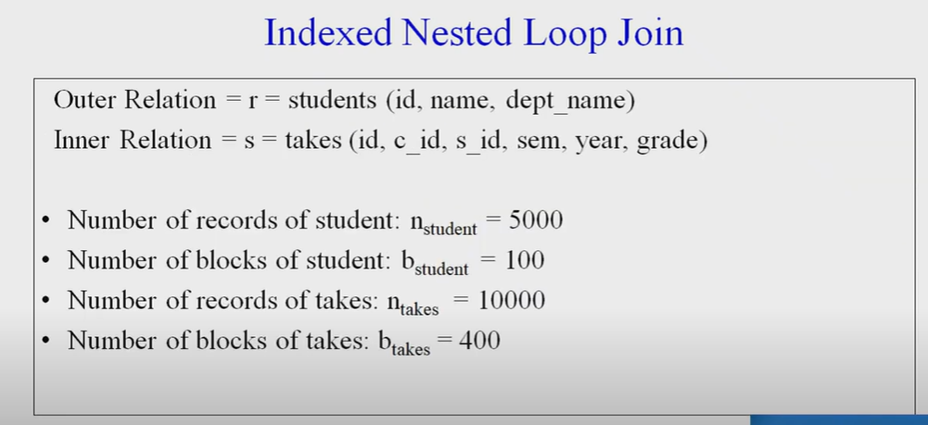

Slide 24
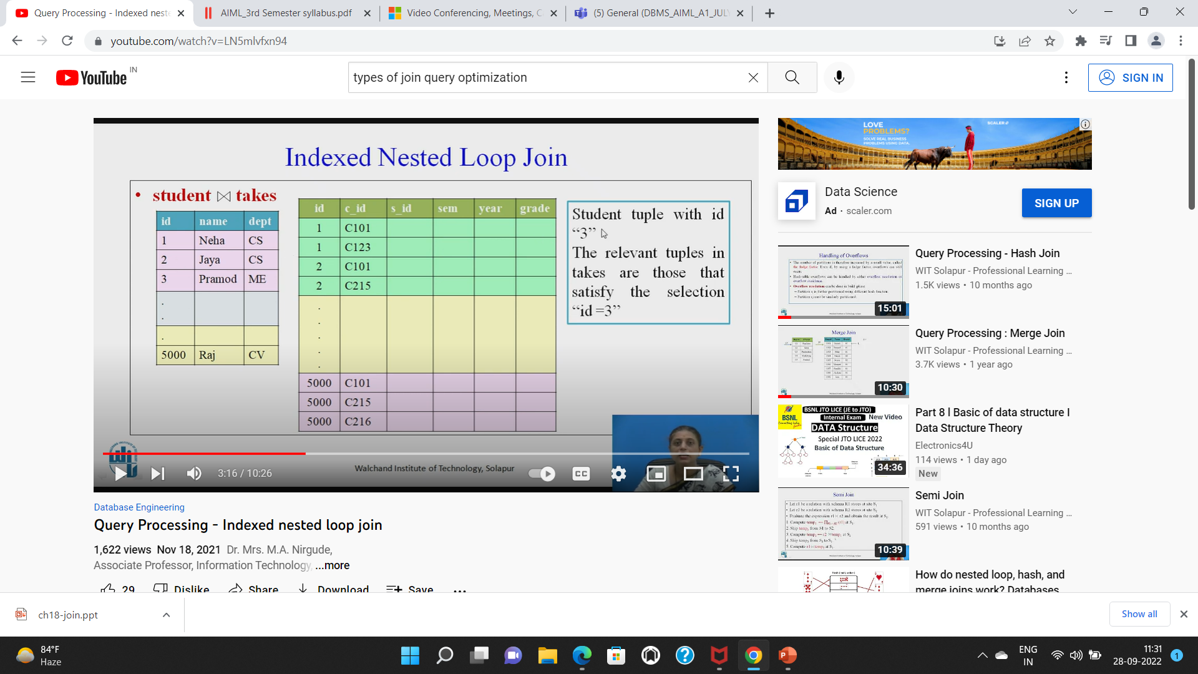

Slide 25
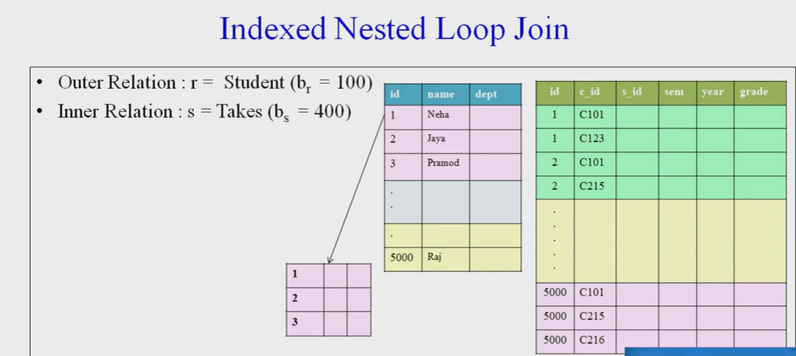

Slide 26
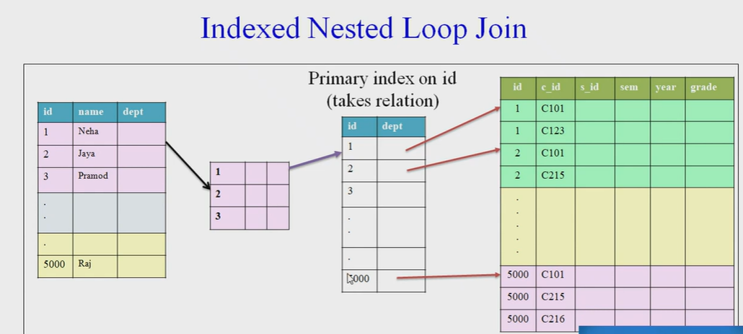

Slide 27
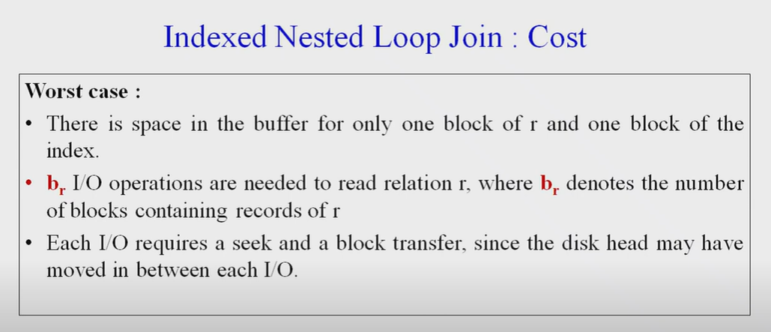

Slide 28
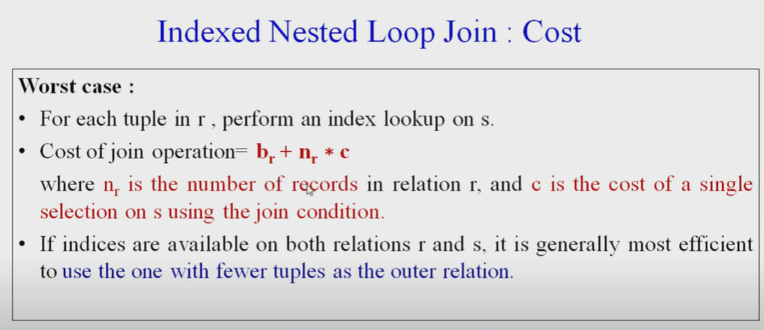

Slide 29
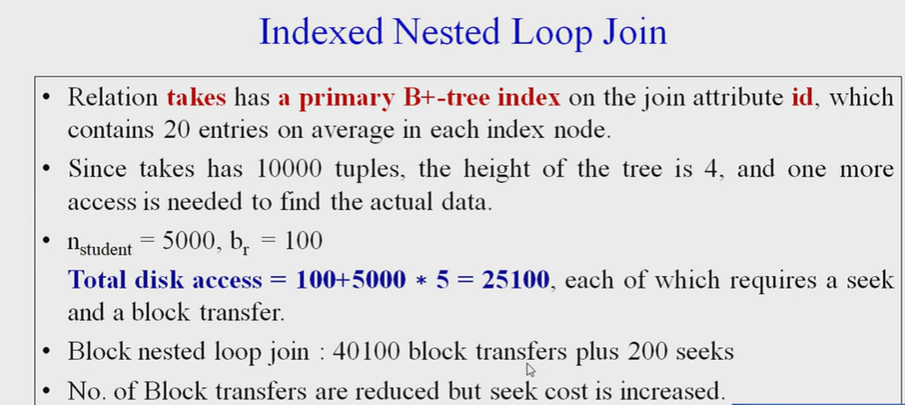

Slide 30
Merge Join
Used to compute natural join and equi-joins
Let r(R) and s(S) be the relations whose natural join is to be computed.let R∩S denotes their common attributes.
Both relations are sorted on the attributes R∩S

Slide 31
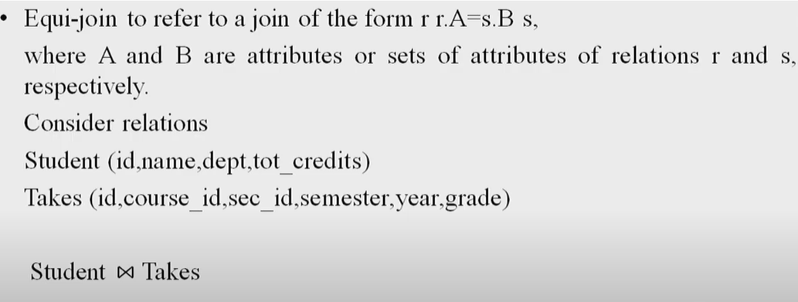
Join operation

Slide 32
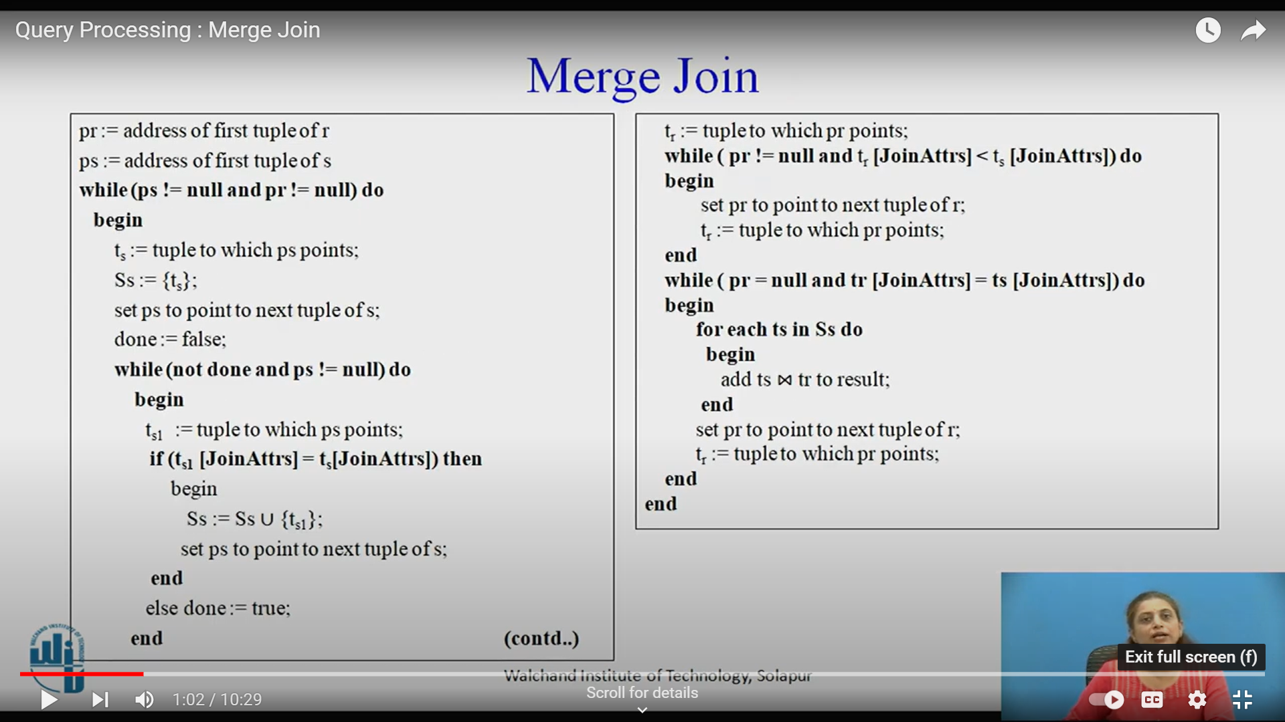

Slide 33
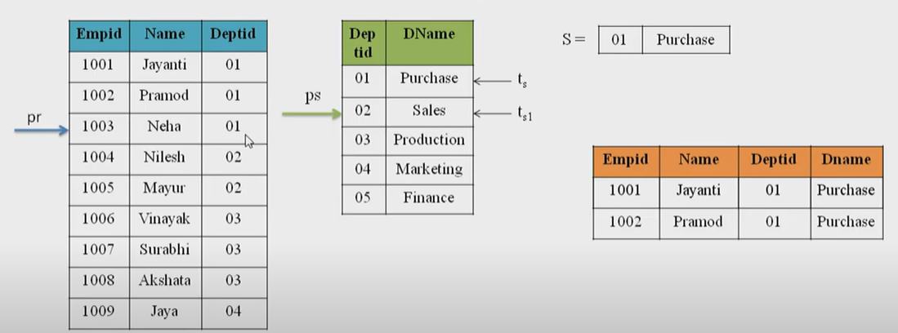
Merge join

Slide 34
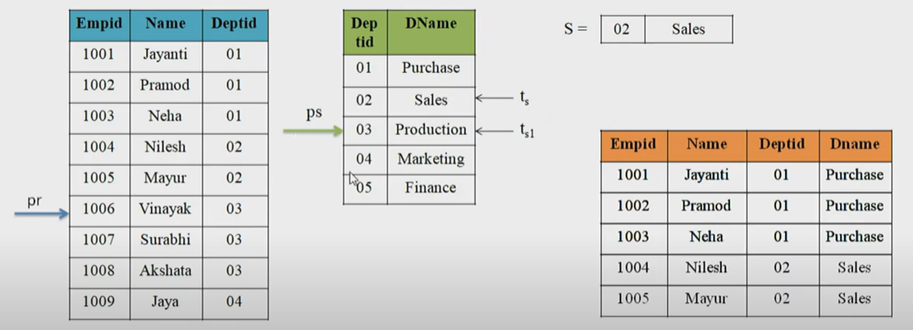
Merge join

Slide 35
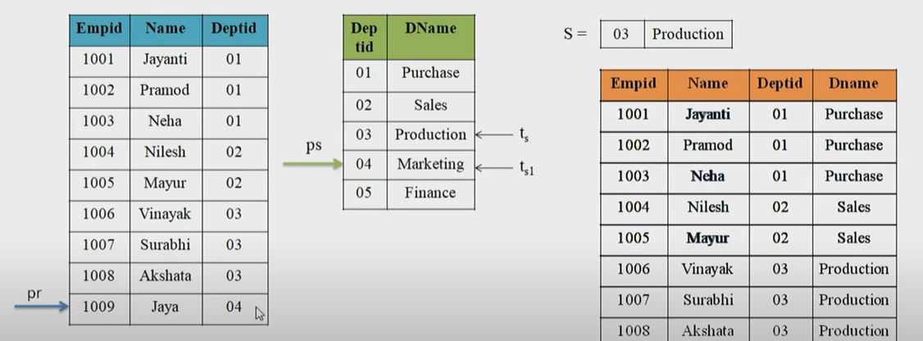
Merge sort

Slide 36
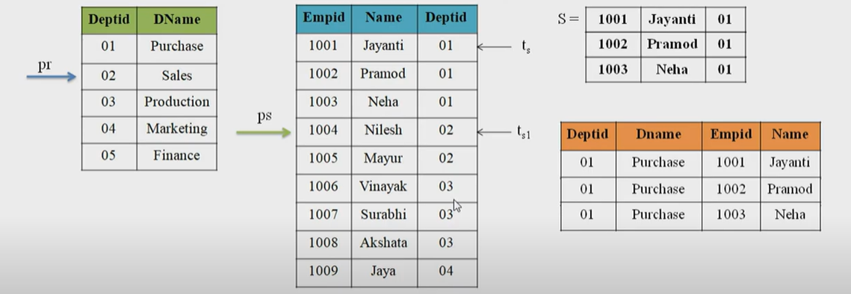
Merge join

Slide 37
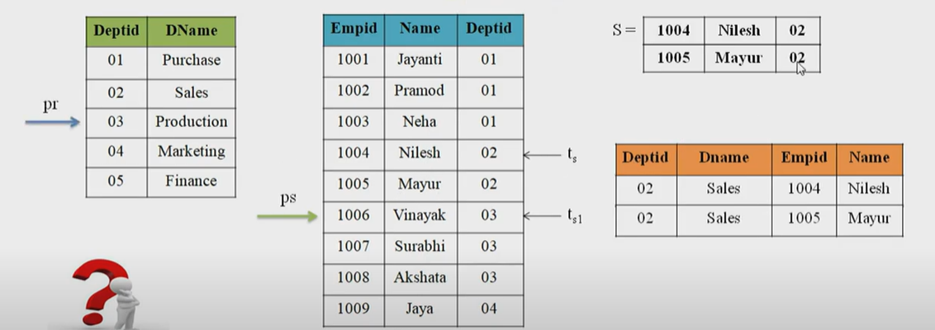
Merge join

Slide 38
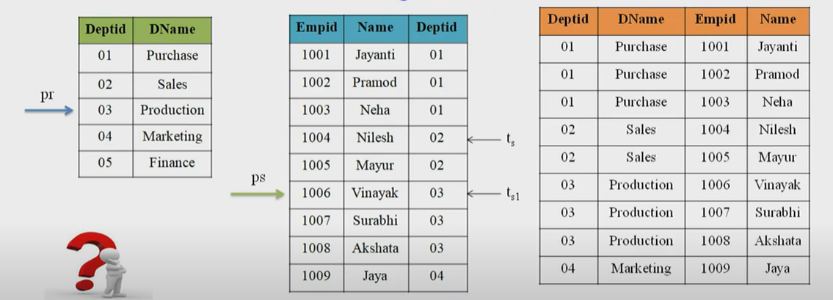
Merge join

Slide 39
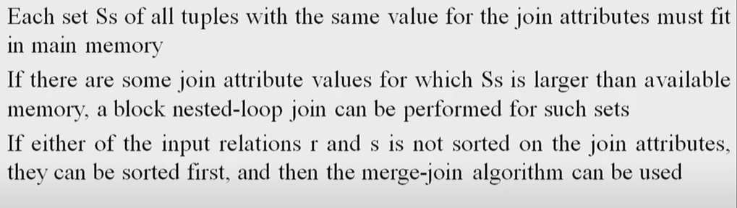
Merge Join Requirements

Slide 40
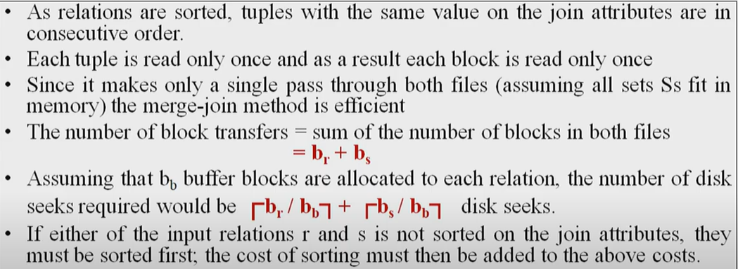
Cost Analysis

Slide 41
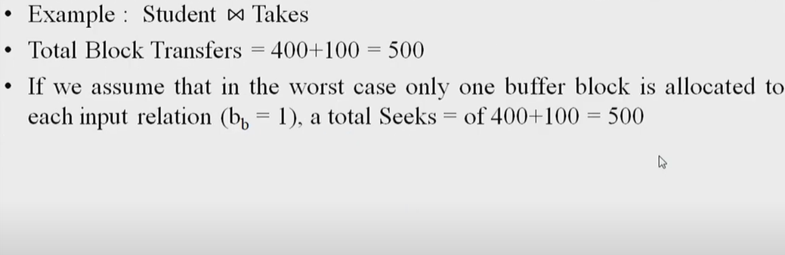

Slide 42
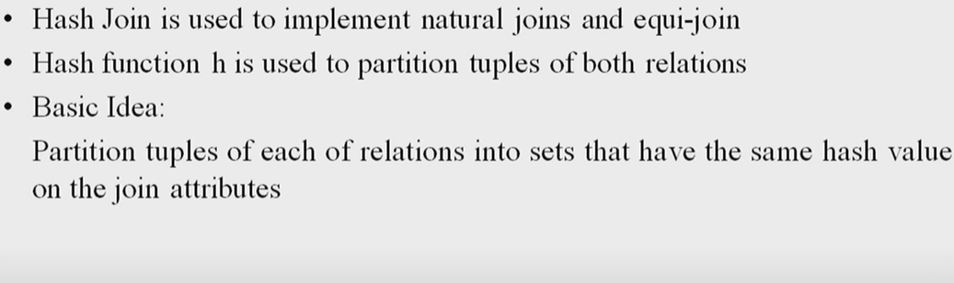
Hash Join

Slide 43
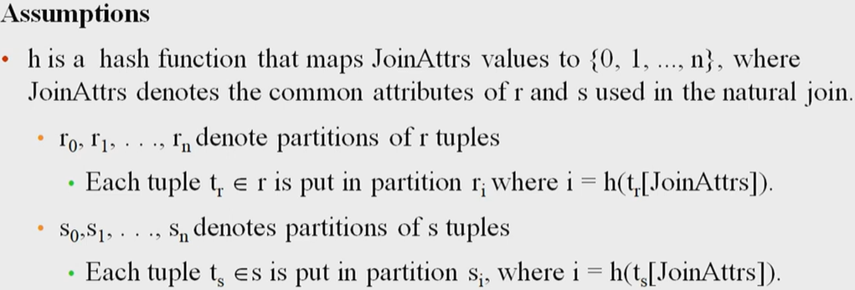
Hash join

Slide 44
Hash-Join (Cont.)

Slide 45
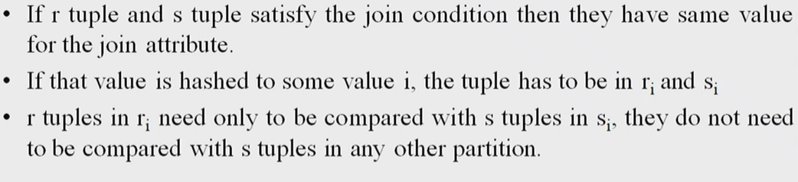
Hash join

Slide 46
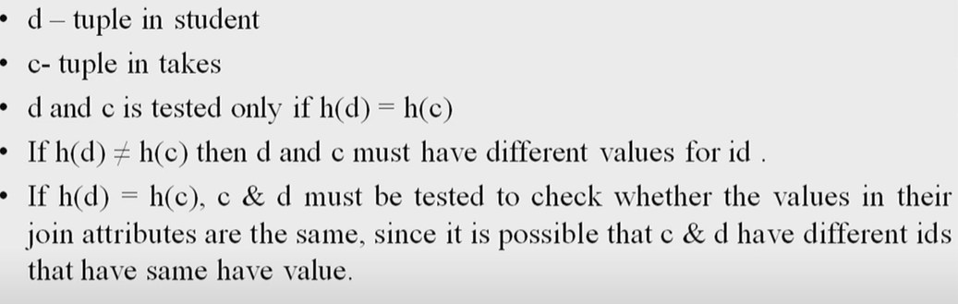

Slide 47
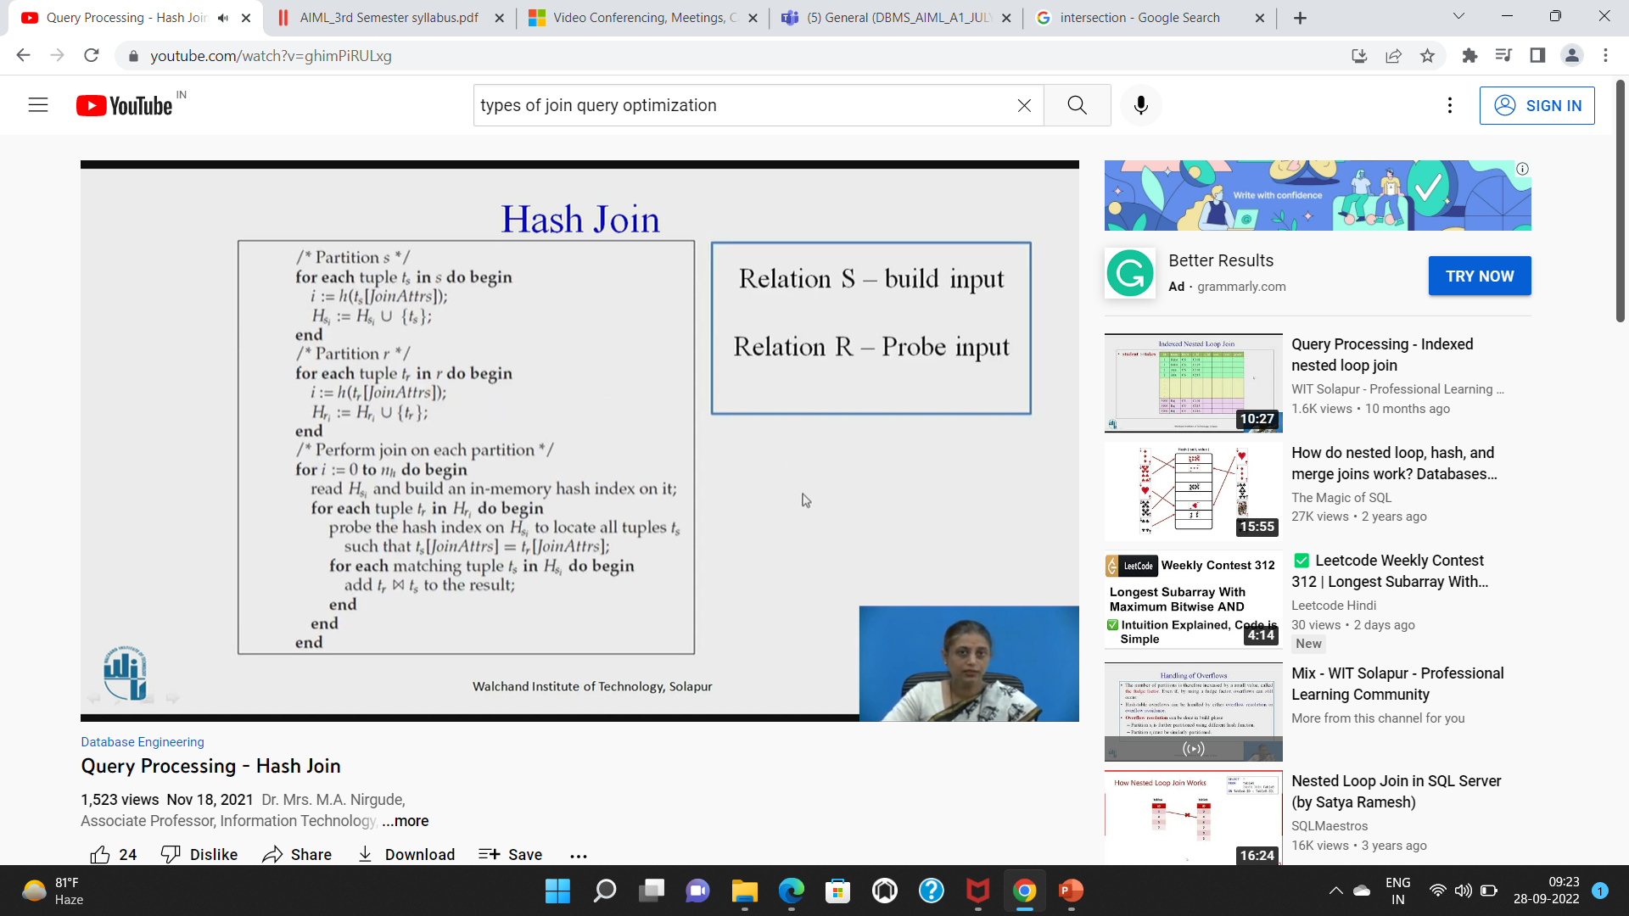

Slide 48
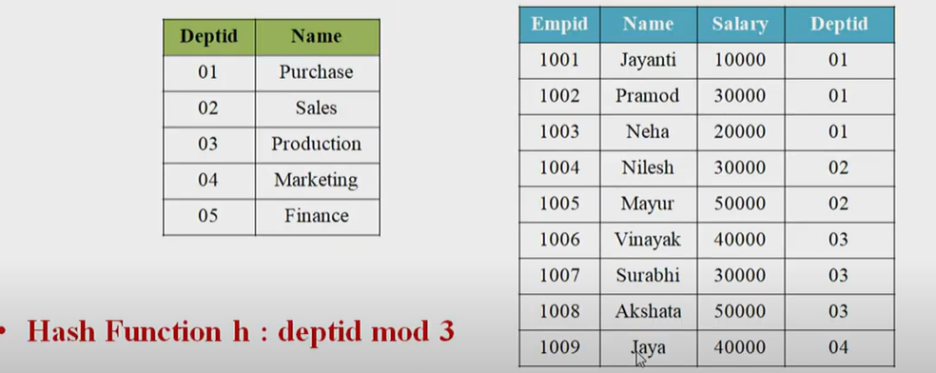

Slide 49
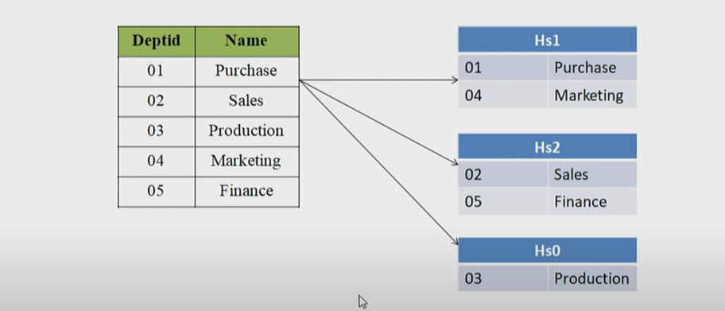

Slide 50
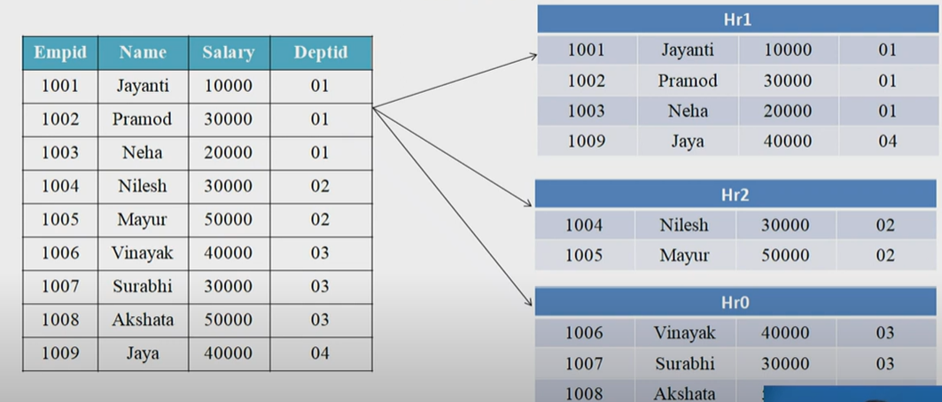

Slide 51
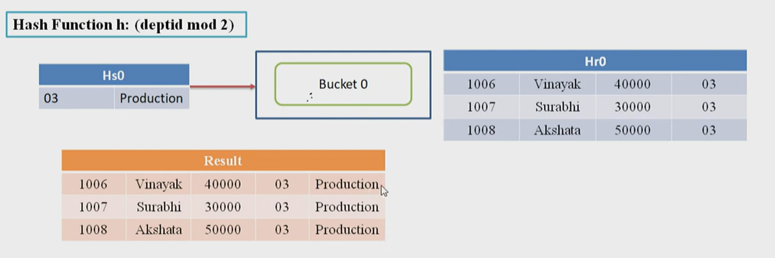

Slide 52
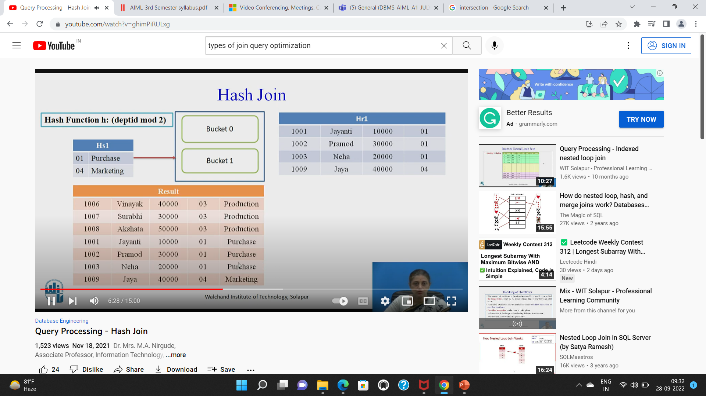

Slide 53
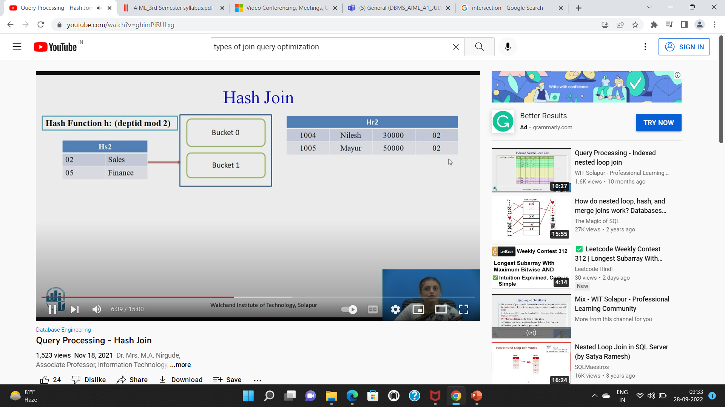
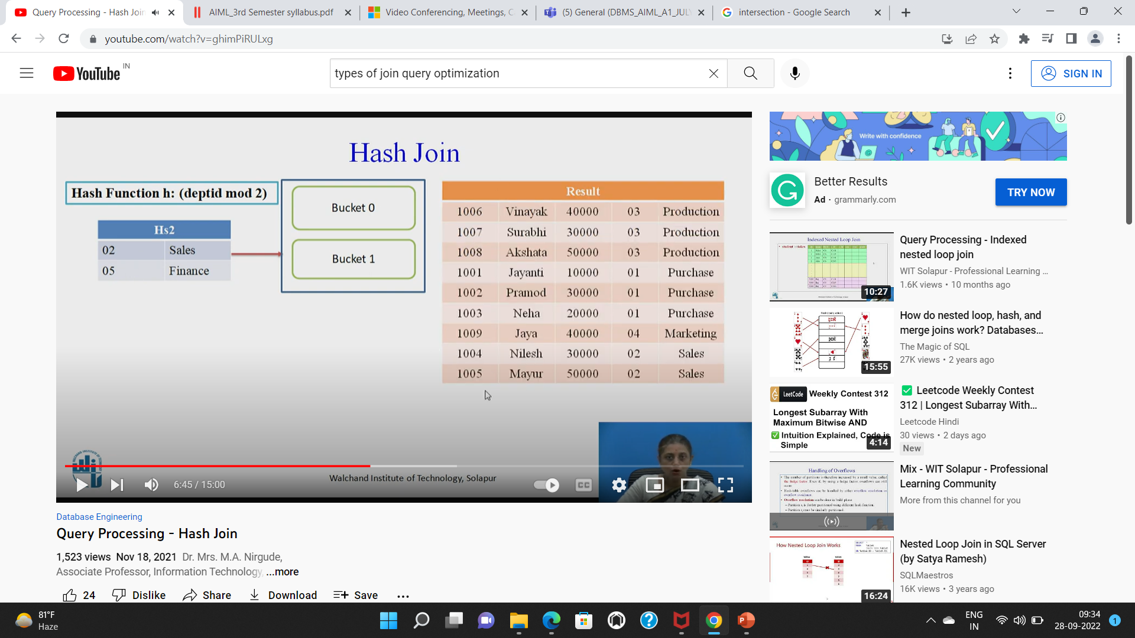

Slide 54
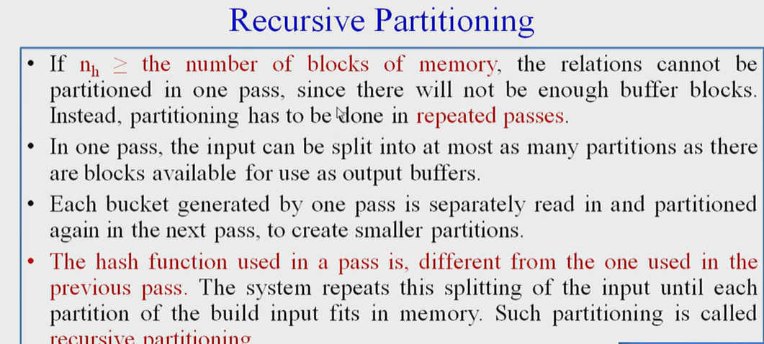

Slide 55
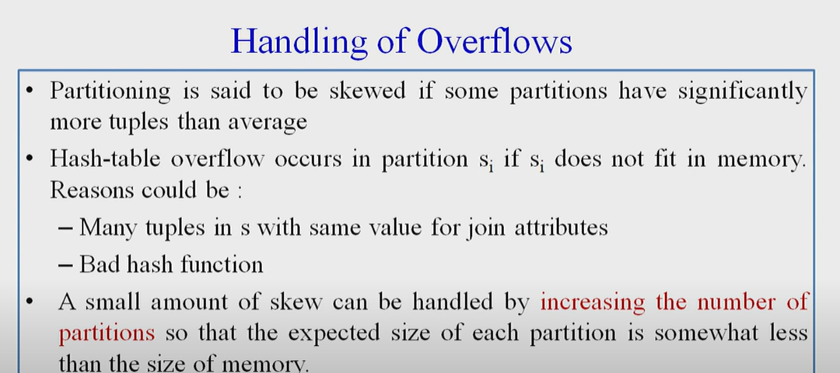

Slide 56


Slide 57


Slide 58


Slide 59


Slide 60


Slide 61
4. Algorithms for PROJECT and SET Operations (1)
Algorithm for PROJECT operations (Figure 15.3b)
π _{<attribute list>}(R)
If <attribute list> has a key of relation R, extract all tuples from R with only the values for the attributes in <attribute list>.
If <attribute list> does NOT include a key of relation R, duplicated tuples must be removed from the results.
Methods to remove duplicate tuples
Sorting
Hashing

Slide 62
Algorithms for PROJECT and SET Operations (2)
Algorithm for SET operations
Set operations:
UNION, INTERSECTION, SET DIFFERENCE and CARTESIAN PRODUCT
CARTESIAN PRODUCT of relations R and S include all possible combinations of records from R and S. The attribute of the result include all attributes of R and S.
Cost analysis of CARTESIAN PRODUCT
If R has n records and j attributes and S has m records and k attributes, the result relation will have n*m records and j+k attributes.
CARTESIAN PRODUCT operation is very expensive and should be avoided if possible.

Slide 63
Algorithms for PROJECT and SET Operations (3)
Algorithm for SET operations (contd.)
UNION (See Figure 15.3c)
Sort the two relations on the same attributes.
Scan and merge both sorted files concurrently, whenever the same tuple exists in both relations, only one is kept in the merged results.
INTERSECTION (See Figure 15.3d)
Sort the two relations on the same attributes.
Scan and merge both sorted files concurrently, keep in the merged results only those tuples that appear in both relations.
SET DIFFERENCE R-S (See Figure 15.3e)
Keep in the merged results only those tuples that appear in relation R but not in relation S.

Slide 64
5. Implementing Aggregate Operations and Outer Joins (1)
Implementing Aggregate Operations:
Aggregate operators:
MIN, MAX, SUM, COUNT and AVG
Options to implement aggregate operators:
Table Scan
Index
Example
SELECT MAX (SALARY)
FROM EMPLOYEE;
If an (ascending) index on SALARY exists for the employee relation, then the optimizer could decide on traversing the index for the largest value, which would entail following the right most pointer in each index node from the root to a leaf.

Slide 65
Implementing Aggregate Operations and Outer Joins (2)
Implementing Aggregate Operations (contd.):
SUM, COUNT and AVG
For a dense index (each record has one index entry):
Apply the associated computation to the values in the index.
For a non-dense index:
Actual number of records associated with each index entry must be accounted for
With GROUP BY: the aggregate operator must be applied separately to each group of tuples.
Use sorting or hashing on the group attributes to partition the file into the appropriate groups;
Computes the aggregate function for the tuples in each group.
What if we have Clustering index on the grouping attributes?

Slide 66
Implementing Aggregate Operations and Outer Joins (3)
Implementing Outer Join:
Outer Join Operators:
LEFT OUTER JOIN
RIGHT OUTER JOIN
FULL OUTER JOIN.
The full outer join produces a result which is equivalent to the union of the results of the left and right outer joins.
Example:
SELECT FNAME, DNAME
FROM (EMPLOYEE LEFT OUTER JOIN DEPARTMENT
ON DNO = DNUMBER);
Note: The result of this query is a table of employee names and their associated departments. It is similar to a regular join result, with the exception that if an employee does not have an associated department, the employee's name will still appear in the resulting table, although the department name would be indicated as null.

Slide 67
Implementing Aggregate Operations and Outer Joins (4)
Implementing Outer Join (contd.):
Modifying Join Algorithms:
Nested Loop or Sort-Merge joins can be modified to implement outer join. E.g.,
For left outer join, use the left relation as outer relation and construct result from every tuple in the left relation.
If there is a match, the concatenated tuple is saved in the result.
However, if an outer tuple does not match, then the tuple is still included in the result but is padded with a null value(s).

Slide 68
Implementing Aggregate Operations and Outer Joins (5)
Implementing Outer Join (contd.):
Executing a combination of relational algebra operators.
Implement the previous left outer join example
{Compute the JOIN of the EMPLOYEE and DEPARTMENT tables}
TEMP1π_{FNAME,DNAME}(EMPLOYEE _{DNO=DNUMBER} DEPARTMENT)
{Find the EMPLOYEEs that do not appear in the JOIN}
TEMP2  π _{FNAME} (EMPLOYEE) - π_{FNAME} (Temp1)
{Pad each tuple in TEMP2 with a null DNAME field}
TEMP2  TEMP2 x 'null'
{UNION the temporary tables to produce the LEFT OUTER JOIN}
RESULT  TEMP1 υ TEMP2
The cost of the outer join, as computed above, would include the cost of the associated steps (i.e., join, projections and union).

Slide 69
6. Combining Operations using Pipelining (1)
Motivation
A query is mapped into a sequence of operations.
Each execution of an operation produces a temporary result.
Generating and saving temporary files on disk is time consuming and expensive.
Alternative:
Avoid constructing temporary results as much as possible.
Pipeline the data through multiple operations - pass the result of a previous operator to the next without waiting to complete the previous operation.

Slide 70
Combining Operations using Pipelining (2)
Example:
For a 2-way join, combine the 2 selections on the input and one projection on the output with the Join.
Dynamic generation of code to allow for multiple operations to be pipelined.
Results of a select operation are fed in a "Pipeline" to the join algorithm.
Also known as stream-based processing.

